Slide 1


PharmaConnect: Connecting Patients with Pharmacies

Slide 2
Team members:
Mohamed Hesham Mohamed Ghonem
Youssef Mohamed Mahmoud
Ali Ayman Ali
Abdallah Tarek Abdallah

Slide 3
Introduction to PharmaConnect
CONNECTING PATIENTS
PharmaConnect is designed to seamlessly connect patients with local pharmacies, enhancing access to essential medications through an intuitive interface.
KEY FEATURES
Users can easily locate nearby pharmacies, and book consultations, ensuring a comprehensive healthcare experience at their fingertips.

Slide 4
Understanding Our Target Audience and Business Model
EGYPTIAN PATIENTS' NEEDS
PharmaConnect aims to serve Egyptian patients seeking easy access to nearby pharmacies while generating revenue through commissions, subscriptions, and ads.

Slide 5
Market Context
HEALTHCARE LANDSCAPE IN EGYPT
Egypt's healthcare system is evolving, with increasing demand for digital solutions that enhance patient access to pharmacies and streamline medication procurement.
The Egypt e‑pharmacy and digital health platforms market is valued at USD 59 million in 2024.

Slide 6
Opportunities for PharmaConnect
ACCESSIBILITY CHALLENGES
Many patients in Egypt encounter difficulties accessing pharmacies, leading to delays in medication procurement and missed health consultations.
MARKET SIZE ESTIMATES
The digital pharmacy market in Egypt is projected to grow significantly, with estimates suggesting a big opportunity as online health solutions gain traction.

Slide 7
SWOT Analysis of PharmaConnect
STRENGTHS
PharmaConnect leverages local market knowledge to create a user-friendly platform that simplifies patient-pharmacy interactions in Egypt's healthcare landscape. Also, it will get revenue from all the pharmacies contracted with it as of marketing and the process.
WEAKNESSES
As a new entrant, PharmaConnect faces technology adoption barriers among users and must ensure strong cooperation from pharmacies to succeed.

Slide 8
Opportunities and Threats
Opportunities
The increasing demand for digital health solutions presents significant opportunities for PharmaConnect to enhance patient access and convenience in Egypt.
Threats
Regulatory changes and competition from established players pose challenges, potentially impacting PharmaConnect's market entry and growth strategies in the healthcare landscape.

Slide 9
Project Steps:
Data Exploration
Data Cleaning
Data Modeling
Insights Extraction
Dashboard Creation

Slide 10
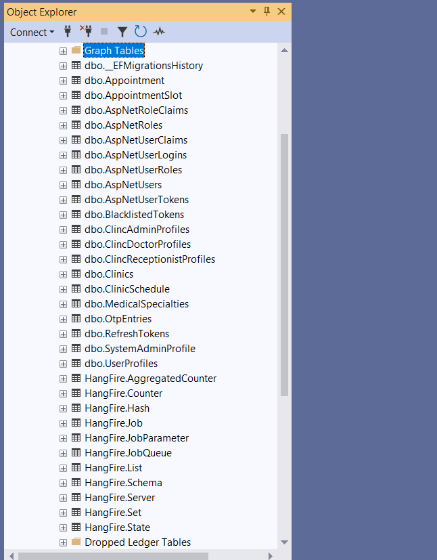
Data Exploration
The data was received from the backend team as a backup file, so we explored it through Sql Server Management Studio and found 32 tables each had its own attributes, while lots of them was for related to the backend code, we extracted the needed information from 7 tables

Slide 11
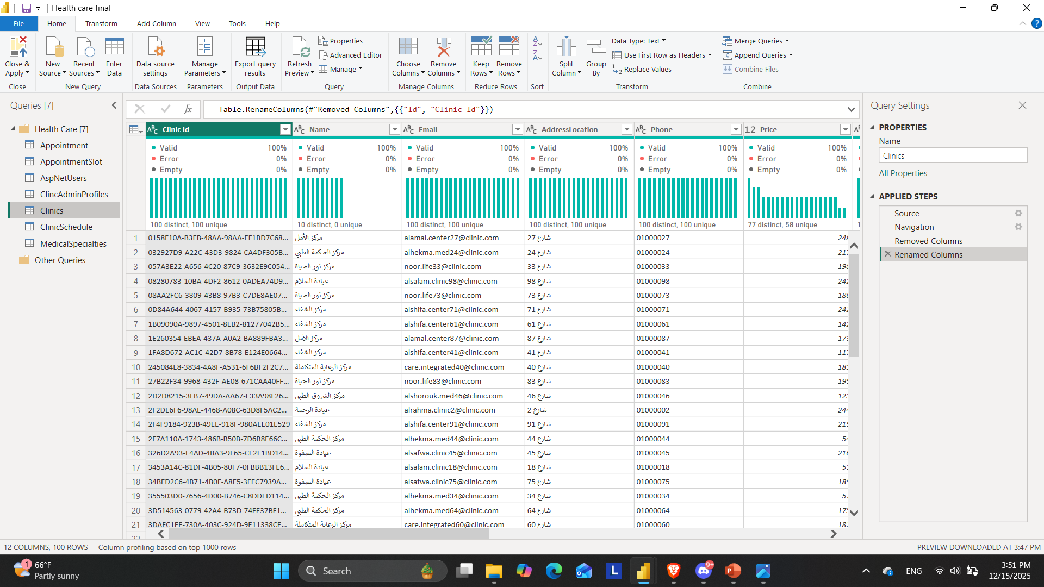
Data Cleaning
The dataset was reviewed and cleaned to improve quality and usability. All null (empty) tables and columns containing no meaningful data were identified and removed. This process ensured that the remaining data is relevant, complete, and consistent, making it suitable for accurate analysis and reporting.

Slide 12
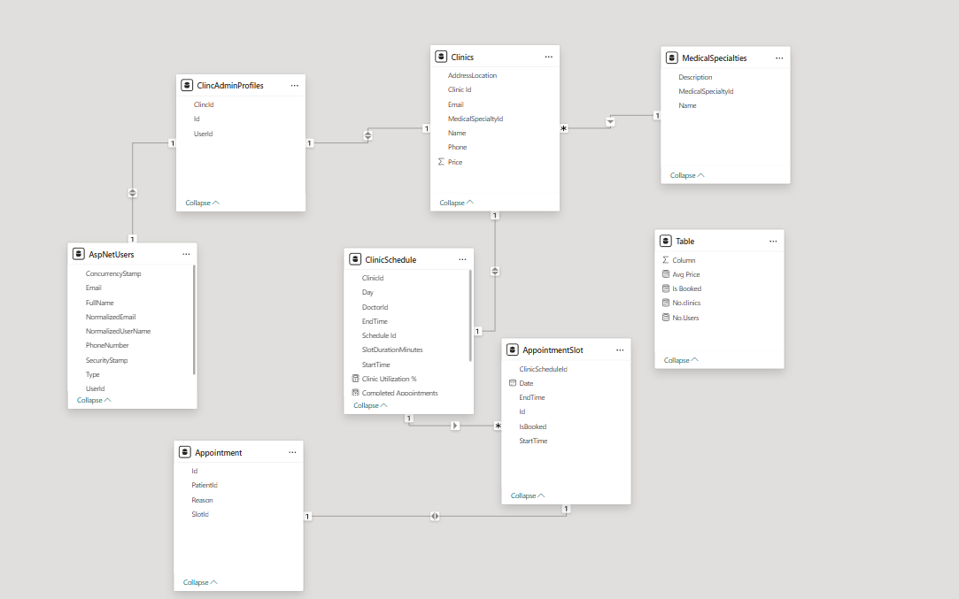
Data Modeling

Slide 13
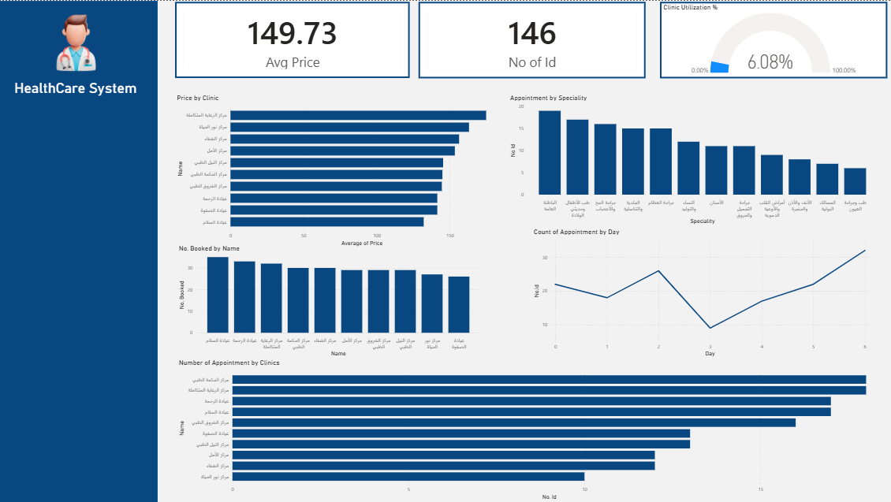
Dashboard Creation

Slide 14


Conclusion: Connecting Egypt to Better Medical Access
Thanks!!

